Slide 1


Project
Discussion

Slide 2
Team Members
Shreyash Shete
Ahilya Bandgar
Alisha Shaikh
Gauri Pingat
Komal More
Mrunal Nigade
Nikhil Chavan
Ruchira Kadam
Rutuja Pawale
Saurabh Gaikwad
Shubham Gaikwad
Vaishnavi Katore
Vimukta Rokade

Slide 3
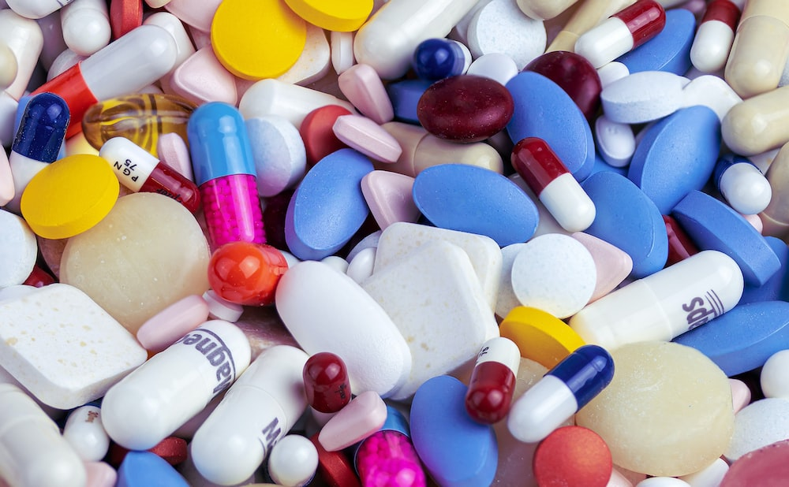
Medicines for all
Medicine price comparing website and suggest the lowest price website

Slide 4
Synopsis
Our Website will check the availability of medicine, compare it's price on other websites like pharm-easy, netmeds.
Suggest the lowest price available on a particular website.
Check the contents of the particular medicine and suggest similar medicine if original or prescribed is not available.
Our website will work just like trivago.

Slide 5
Why this topic ?
Our E-pharmacy website will save the time and money of the consumer by comparing it's live price to the other available websites like pharm - easy or 1mg.
Because E-pharmacy model is the lack of physical availability, if the preferred medicine is not currently available. We cannot suggest another similar but the medicine with similar contents and of another company authorized by IMA.
Our website will recommend a similar medicine to the user if the
preferred medicine is not available on these websites.
Content may not be copied, reproduced, distributed, displayed, downloaded or otherwise used for any purpose without the prior written consent of owners

Slide 6


Plan of Action
Web scrapping (Scrap the data from web platform)
Use of API ( application programming interface )
Manually adding the data into the webiste.
use of on demand data.

Slide 7
Sources
https://agilie.com/blog/guide-on-how-to-create-a-price-comparison-website
https://davaninja.com/tabs/search
https://www.1mg.com/
https://www.trivago.com/

Slide 8

Thank You

